Slide 1
Systems Analysis and Design 11th Edition
Chapter 8
User Interface Design

Slide 2
Chapter Objectives
Explain the concept of user interface design and human-computer interaction, including basic principles of user-centered design
Explain how experienced interface designers perform their tasks
Describe rules for successful interface design
Discuss input and output technology issues

Slide 3
Chapter Objectives (Cont.)
Design effective source documents and forms
Explain printed output guidelines
Describe output and input controls and security
Explain modular design and prototyping techniques

Slide 4
Systems Design Phase Overview
Goal of systems design - To build a system that is effective, reliable, and maintainable
A system is:
Effective if it supports business requirements and meets user needs
Reliable if it handles input errors, processing errors, hardware failures, or human mistakes
Maintainable if it is flexible, scalable, and easily modified

Slide 5
Systems Design Phase Overview (Cont.)
Will It Succeed?
Suggestions for successful design
Think like a user
Carefully examine any point where users provide input or receive output
Anticipate future needs and provide flexibility
Anticipate possible expansion
Offer several alternatives
Manage data effectively
System should enter and verify data as soon as possible
Input data must be close to its source
A secure system must include audit trails

Slide 6
Chapter Overview
Users can design their own output
System designers are more aware of user needs and desires
Centralized IT departments no longer produce reams of printed reports
Customer-designed output is the current trend
The user interface has evolved
Most user information needs can be met with screen-generated data
Continues to evolve with the use of mobile and wearable devices

Slide 7

What Is a User Interface?
Describes how users interact with a computer system
Comprises features that affect two-way communications between the user and the computer
Central to usability
In a user-centered system, the distinction blurs between input, output, and the interface itself
FIGURE 8-2 Apple has long been a leader in creating elegant user interfaces for its products.
Source: Apple

Slide 8

What Is a User Interface?(Cont.)
Human-Computer Interaction (HCI)
Describes the relationship between computers and people who use them to perform their jobs
Early user interfaces – Complex commands and graphical user interface (GUI)
Transparent user interface: Does not distract the user
Objective - To create a user-friendly design that is easy to learn and use
Figure 8-3 HCI is essential to employee productivity, whether the work is done in a traditional office setting or on a construction site like the one shown in this figure.
Goodluz/Shutterstock.com

Slide 9
Seven Habits of Successful Interface Designers
Understand the Business
The interface designer must understand:
The underlying business functions
How the system supports individual, departmental, and enterprise goals
Maximize Graphical Effectiveness
A well-designed interface enables rapid learning
Think Like a User
The designer must see the system from a user’s perspective

Slide 10
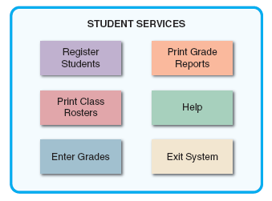
Seven Habits of Successful Interface Designers (Cont. 1)
Use Models and Prototypes
Designers can present initial screen designs to users in the form of a storyboard
Users should test the design and provide feedback
Focus on Usability
Include main options in the opening screen
Offer a reasonable number of choices that a user easily can comprehend
FIGURE 8-5 The opening screen displays the main options for a student registration system. A user can click an option to see lower-level actions and menu choices.

Slide 11
Seven Habits of Successful Interface Designers (Cont. 2)
Invite Feedback
Monitor system usage and solicit user suggestions
Determine if system features are being used as intended by observing and surveying users
Document Everything
Document all screen designs for later use by programmers
User-approved sketches and storyboards can be used to document the user interface

Slide 12
Guidelines for User Interface Design
Create an Interface That Is Easy to Learn and Use
Focus on system design objectives
Create a design that is easy to understand and remember
Provide commands, actions, and system responses that are consistent and predictable
Allow users to correct errors easily
Clearly label all controls, buttons, and icons

Slide 13
Guidelines for User Interface Design (Cont. 1)
Create an Interface That Is Easy to Learn and Use (Cont.)
Select familiar images that users can understand
Provide on-screen instructions that are logical, concise, and clear
Show all commands in a list of menu items
Dim any commands that are not available to the user
Make it easy to navigate or return to any level in the menu structure

Slide 14
Guidelines for User Interface Design (Cont. 2)
Enhance User Productivity
Organize tasks, commands, and functions in groups that resemble actual business operations
Create alphabetical menu lists or place the selections used frequently at the top of the menu list
Provide shortcuts for experienced users
Use default values if the majority of values in a field are the same
Use a duplicate value function, but allow users to turn this feature on or off as they prefer

Slide 15
Guidelines for User Interface Design (Cont. 3)
Enhance User Productivity (Cont.)
Provide a fast-find feature
If available, consider a natural language feature that allows users to type commands or requests in normal text phrases
Provide Users with Help and Feedback
Ensure that help is always available on demand
Provide user-selected help and context- sensitive help
Provide a direct route for users to return to the point from where help was requested
Include contact information

Slide 16
Guidelines for User Interface Design (Cont. 4)
Provide Users with Help and Feedback (Cont.)
Require user confirmation before data deletion
Provide an “Undo” key
When a user-entered command contains an error, highlight the erroneous part
Use hypertext links to assist users
Display messages at a logical place on the screen
Alert users to lengthy processing times or delays
Allow messages to remain on the screen long enough for users to read them
Let the user know whether the task or operation was successful or not

Slide 17
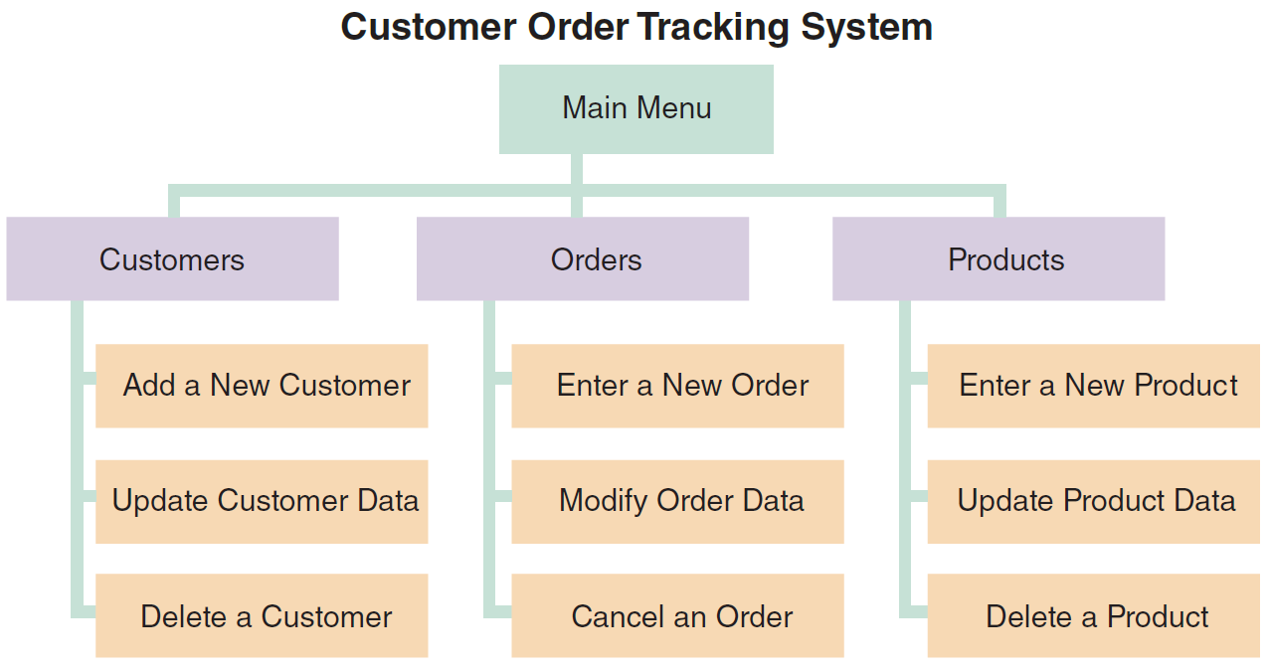
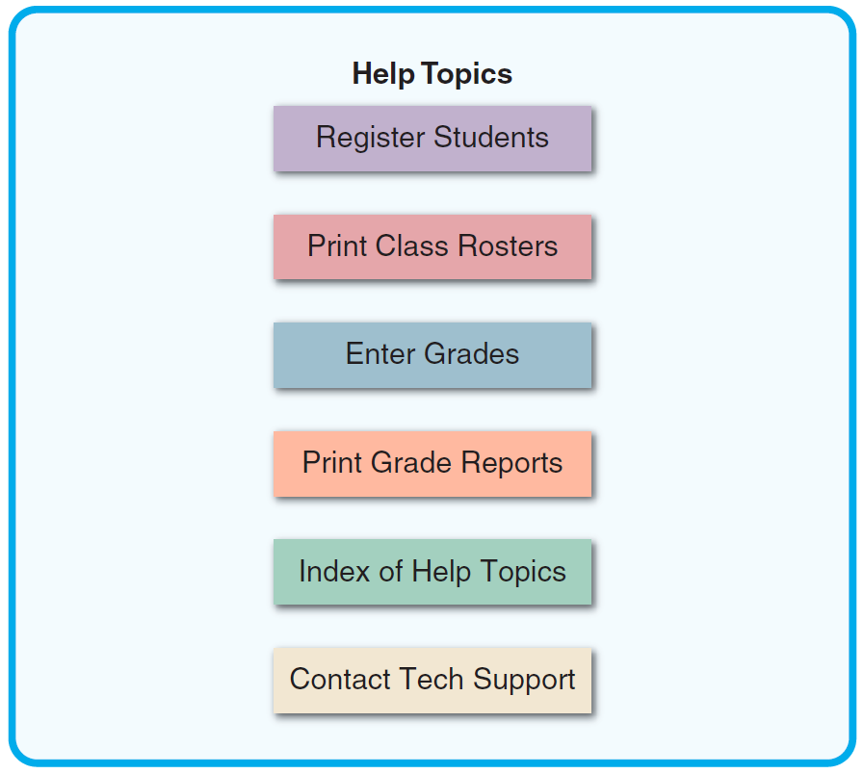
Guidelines for User Interface Design (Cont. 5)
Figure 8-7 This menu hierarchy shows tasks, commands, and functions organized into logical groups and sequences. The structure resembles a functional decomposition diagram (FDD), which is a model of business functions and processes.
Figure 8-8 The main Help screen for a student registration system.

Slide 18
Guidelines for User Interface Design (Cont. 6)
Provide Users with Help and Feedback (Cont.)
Provide a text explanation for an icon or image on a control button
Use messages that are specific, understandable, and professional
Create an Attractive Layout and Design
Use appropriate colors to highlight different areas of the screen
Use special effects sparingly
Use hyperlinks that allow users to navigate to related topics
Group related objects and information

Slide 19
Guidelines for User Interface Design (Cont. 7)
Create an Attractive Layout and Design (Cont.)
Display titles, messages, and instructions in a consistent manner
Ensure that commands and similar mouse actions will have the same effect
Require the user to confirm the entry by pressing Enter or Tab
Remember that users are accustomed to a pattern of red = stop, yellow = caution, and green = go
Provide a keystroke alternative for each menu command
Avoid complex terms and technical jargon

Slide 20
Guidelines for User Interface Design (Cont. 8)
Enhance the Interface
Opening screen is important as it introduces the application
The starting point can be a switchboard with well- placed command buttons for navigation
Use a command button to initiate an action
Try to create customized menu bars and toolbars
Add a shortcut feature that lets a user select a menu command
If variable input data is needed, provide a dialog box that explains what is required

Slide 21
Guidelines for User Interface Design (Cont. 9)
Enhance the Interface (Cont.)
A toggle button makes it easy to show on or off status
Use list boxes that display the available choices
Use an option button, or a radio button, to control user choices
If check boxes are used to select one or more choices from a group, show the choices with a checkmark or an X
When dates must be entered, use a calendar control

Slide 22
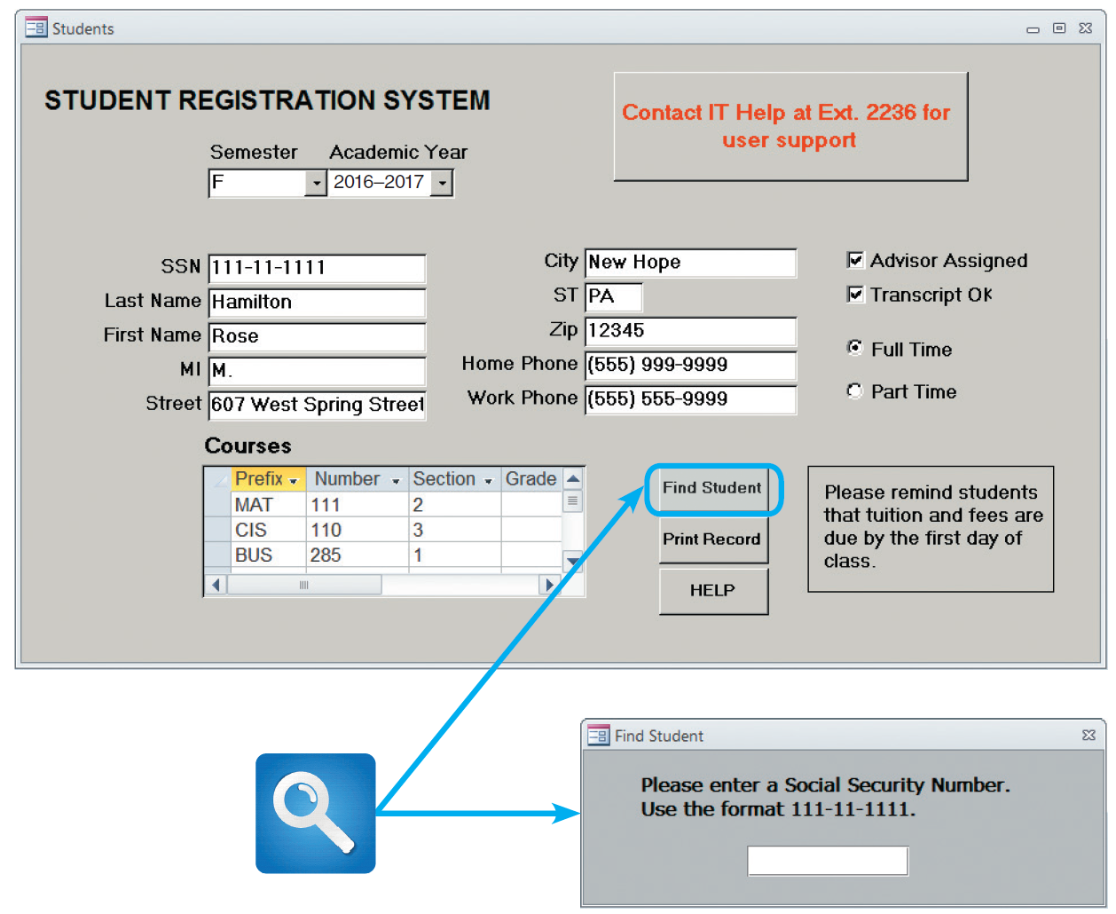
Guidelines for User Interface Design (Cont. 10)
FIGURE 8-10 A data entry screen for the student registration system. This screen uses several design features that are described in the text. When a user clicks the Find Student command button, a dialog box is displayed with instructions.

Slide 23
Guidelines for User Interface Design (Cont. 11)
Focus on Data Entry Screens
Use the form filling method whenever possible
Restrict user access to screen locations where data is entered
Provide a way to leave the data entry screen at any time without entering the current record
Provide a descriptive caption for every field
Provide a means for users to move among fields on the form in a standard order or in any order they choose
Allow users to add, change, delete, and view records

Slide 24
Guidelines for User Interface Design (Cont. 12)
Focus on Data Entry Screens (Cont.)
Design the screen form layout to match the layout of the source document
Display a sample format like MMDDYY and use an input mask
Require an ending stroke for every field
Do not require users to type leading zeros for numeric fields or trailing zeros for decimals
Display default values
Provide users with an opportunity to confirm the accuracy of input data before displaying it

Slide 25
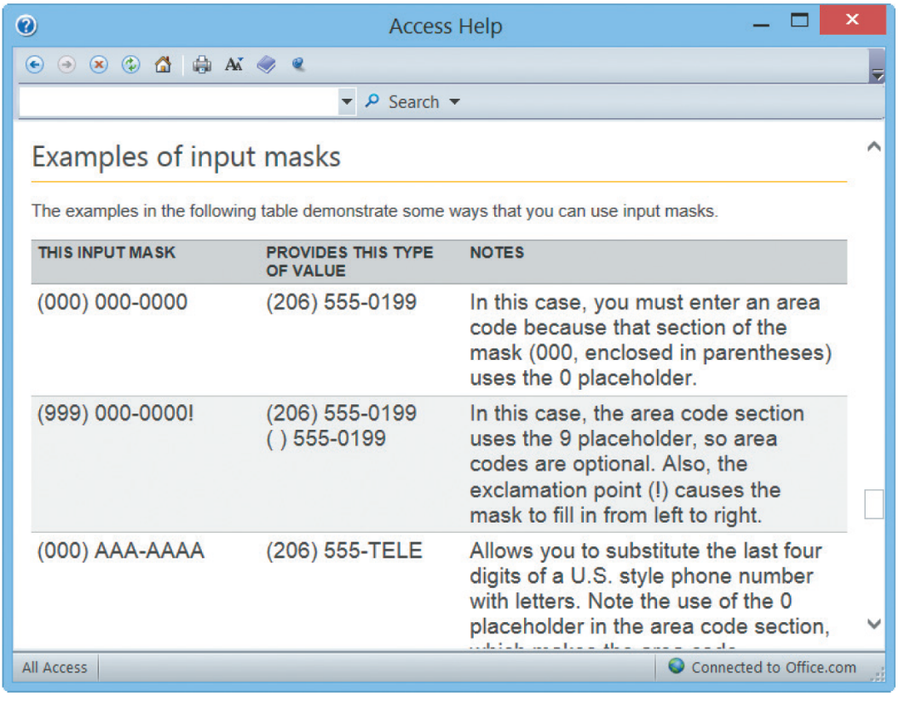
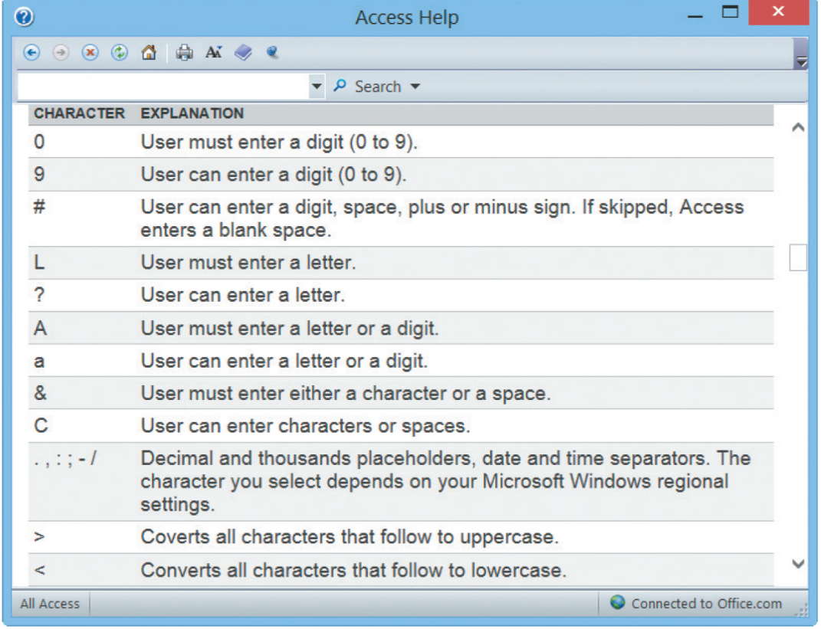
Guidelines for User Interface Design (Cont. 13)
FIGURE 8-12 Microsoft Access provides various input masks for dates, phone numbers, and postal codes, among others. In addition, it is easy to create a custom mask using the characters shown here.

Slide 26
Guidelines for User Interface Design (Cont. 14)
Focus on Data Entry Screens (Cont.)
Use a default value when a field value will be constant for successive records or throughout the data entry session
Use Validation Rules
Sequence check: Used when the data must be in some predetermined sequence
Existence check: Applies to mandatory data items
Data type check: Tests to ensure that a data item fits the required data type
Range check: Used to verify that data items fall between a specified minimum and maximum value

Slide 27
Guidelines for User Interface Design (Cont. 15)
Use Validation Rules (Cont.)
Reasonableness check: Identifies values that are questionable, but not necessarily wrong
Validity check: Used for data items that must have certain values
Combination check: Performed on two or more fields to ensure that they are consistent or reasonable when considered together
Batch controls: Totals used to verify batch input

Slide 28
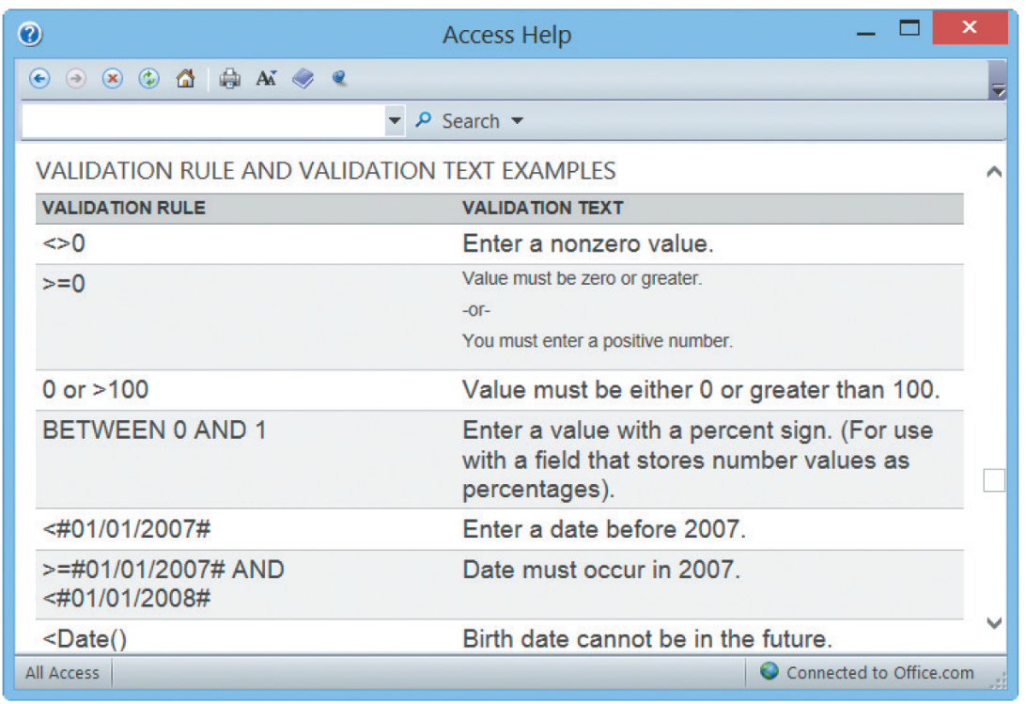
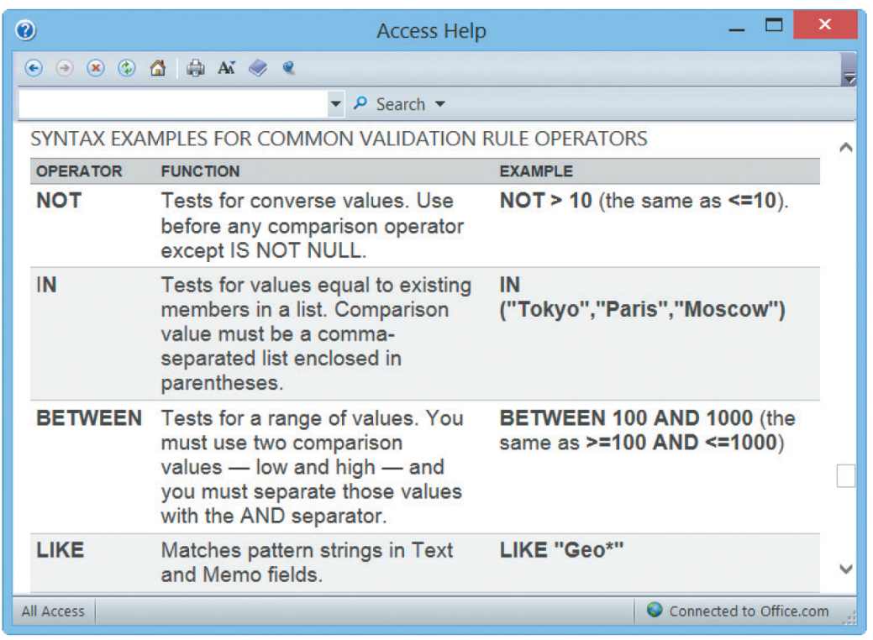
Guidelines for User Interface Design (Cont. 16)
FIGURE 8-13 Microsoft Access provides validation rules can improve data quality by requiring the input to meet specific requirements or conditions.

Slide 29
Guidelines for User Interface Design (Cont. 17)
Reduce Input Volume
Input necessary data only
Do not input data that the user can retrieve from system files or calculate from other data
Do not input constant data
Use codes as they are shorter than the data they represent

Slide 30
Source Document and Form Design
Garbage in, garbage out (GIGO): Quality of the output depends on the quality of the input
Source document: Collects input data, triggers an input action, and provides a record of the original transaction
A good form layout makes the form easy to complete and provides enough space
Information should flow on a form from left to right and top to bottom

Slide 31
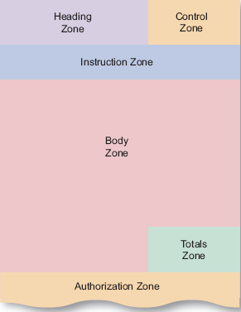
Source Document and Form Design (Cont.)
Order and placement of printed fields should be logical
Totals should be identified clearly
FIGURE 8-14 Source document zones.

Slide 32
Printed Output
Questions to be considered before designing printed output
Why is this being delivered as printed output?
Who wants the information, why is it needed, and how will it be used?
What specific information will be included?
Will the printed output be designed for a specific device?
Do security or confidentiality issues exist?

Slide 33
Printed Output (Cont. 1)
Overview of Report Design
Organizations strive to reduce the flow of paper and printed reports
Users find it handy to view screen output, then print the information they need
Printed output is used in turnaround documents
Reports must be easy to read and well organized
Database programs such as Microsoft Access include a variety of report design tools to create reports quickly and easily

Slide 34
Printed Output (Cont. 2)
Types of Reports
Detail reports: Produce one or more lines of output for each record processed
Can be quite lengthy
Exception reports: Display only those records that meet specific conditions
Useful when the user wants specific information
Summary reports: Reports that provide comprehensive data

Slide 35
Printed Output (Cont. 3)
User Involvement
Users must approve all report designs in advance
A mock-up, or prototype, can be prepared for the users to review
Report Design Principles
Every report should have a report header and footer
Report header: Identifies the report, and contains the report title, date, and other necessary information
Report footer: Contains end-of-report information

Slide 36
Printed Output (Cont. 4)
Report Design Principles (Cont.)
Page headers and footers
Page header: Includes the column headings that identify the data
Page footer: Displays the report title and the page number
Repeating fields
Users’ opinion helps provide clarity
Consistent design
Look and feel are important to users, so reports should be uniform and consistent

Slide 37
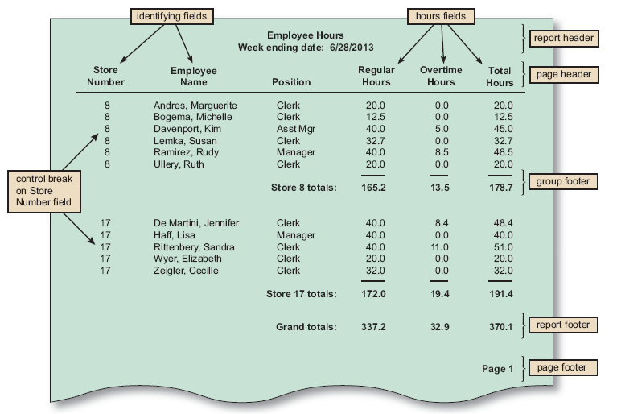
Printed Output (Cont. 5)
FIGURE 8-15 The Employee Hours report is a detail report with control breaks, subtotals, and grand totals. Notice that a report header identifies the report, a page header contains column headings, a group footer contains subtotals for each store, a report footer contains grand totals, and a page footer identifies the page number.

Slide 38
Technology Issues
Output Technology
In addition to screen output and printed matter, output can be delivered in many ways
Actual forms, reports, and documents have to be created to be accessible from workstations, notebooks, tablets, smartphones, and other devices
Internet-based information delivery
Allows users to download a universe of files and documents to support their information needs
Companies use a live or prerecorded webcast to reach prospective customers and investors

Slide 39
Technology Issues (Cont. 1)
Output Technology (Cont.)
Email - An essential means of internal and external business communication
Blogs: Web based logs
Useful for posting news, reviewing current events, and promoting products
Instant messaging - Useful for team members in a collaborative situation
Wireless devices - Data can be transmitted using the Internet across a wide array of devices

Slide 40
Technology Issues (Cont. 2)
Output Technology (Cont.)
Digital audio, images and video
Can be captured and stored in digital format
Can be attached to an email message or inserted as a clip in a Microsoft Word document
Podcasts
Used as sales and marketing tools, and to communicate with the employees
Automated fax or faxback systems
Allow a customer to request a fax using e-mail, via the company Web site, or by telephone

Slide 41
Technology Issues (Cont. 3)
Output Technology (Cont.)
Computer output to microfilm (COM)
Used by large firms to scan and store images of original documents to provide high-quality records management and archiving
Computer output to digital media
Used when many paper documents must be scanned and stored in digital format for quick retrieval

Slide 42
Technology Issues (Cont. 4)
Output Technology (Cont.)
Specialized forms of output
Portable, Web-connected devices that can run multiple apps
Retail point-of-sale terminals that handle credit card transactions
Automatic teller machines (ATMs) that can process bank transactions
Special-purpose printers
Plotters that can produce high-quality images
Electronic detection of data embedded in credit cards, bank cards, and employee identification cards

Slide 43
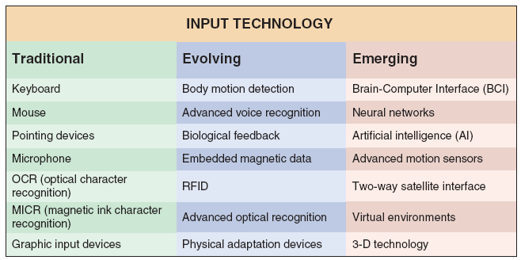
Technology Issues (Cont. 5)
FIGURE 8-17 Input devices can be very traditional, or based on the latest technology.

Slide 44
Technology Issues (Cont. 6)
Input Technology
Batch input: Data entry is performed on a specified time schedule, such as daily, weekly, monthly, or longer
Online data entry
Enables immediate validation and availability of data
Source data automation combines online data entry and automated data capture using input devices such as RFID tags, magnetic data strips, or smartphones
Fast and accurate, and minimizes human involvement in the translation process

Slide 45
Technology Issues (Cont. 7)
Input Technology (Cont.)
Examples of source data automation
Point-of-sale (POS) terminals equipped with bar code scanners and magnetic swipe scanners
Automatic teller machines (ATMs) read data strips on bank cards
Factory employees use magnetic ID cards to clock on and off specific jobs
Hospitals imprint bar codes on patient identification bracelets and use portable scanners when gathering data on patient treatment and medication
Retail stores use portable bar code scanners and libraries use handheld scanners

Slide 46
Technology Issues (Cont. 8)
Input Technology (Cont.)
Trade offs
Manual data entry is slower and more expensive than batch input
Performed at the time the transaction occurs
Often done when computer demand is at its highest
Decision to use batch or online input depends on business requirements

Slide 47
Security and Control Issues
Output Security and Control
Companies use output control methods to maintain output integrity and security
Output security protects privacy rights
Shields the organization’s proprietary data from theft or unauthorized access
Security solutions
Diskless workstation: Network terminal that supports a full-featured user interface but limits the printing or copying of data
Port protector: Controls access to and from workstation interfaces

Slide 48
Security and Control Issues (Cont.)
Input Security and Control
Input control ensures that the input data is correct, complete, and secure
Information should be traceable back to the input data that produced it
Procedures must be put in place for handling source documents to ensure that data is not lost before it enters the system
Data security policies and procedures protect data from loss or damage
Companies should have a records retention policy that meets all legal requirements and business needs
Audit trail files and reports should be stored and saved

Slide 49
Where Do We Go From Here?
Modular Design
Individual components, called modules, connect to a higher-level program or process
Designed to perform a single function
In a structured design, each module represents a specific process
Shown on a data flow diagram (DFD) and documented in a process description
Prototyping
Involves a repetitive sequence of analysis, design, modeling, and testing

Slide 50
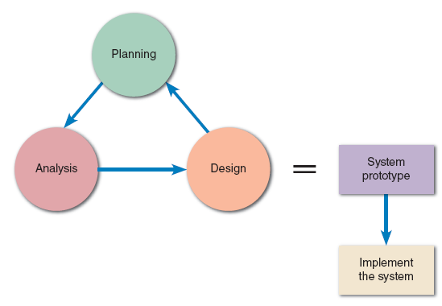
Where Do We Go From Here (Cont. 1)
Prototyping (Cont.)
System prototyping
Produces a full-featured, working model of the information system
Design or throwaway prototyping
Used to verify user requirements and is discarded
FIGURE 8-21 The end product of system prototyping is a working model of the information system, ready for implementation.

Slide 51
Where Do We Go From Here (Cont. 2)
Prototyping (Cont.)
Benefits
Users and systems developers can avoid misunderstandings
System developers can create accurate specifications for the finished system based on the prototype
Managers can evaluate a working model more effectively than a paper specification
Helps in developing testing and training procedures
Reduces the risk and potential financial exposure that occur when a finished system fails to support business needs

Slide 52
Where Do We Go From Here (Cont. 3)
Prototyping (Cont.)
Potential problems
Rapid pace of development can create quality problems which may not be discovered until the finished system is operational
System requirements, such as reliability and maintainability, cannot be tested adequately using a prototype
In complex systems, the prototype can become unwieldy and difficult to manage
Clients may want to adopt the prototype with few to no changes, leading to increased maintenance costs later in the SDLC

Slide 53
Chapter Summary
Purpose of systems design
To create a physical model of the system that satisfies the design requirements that were defined during the systems analysis phase
User interface design must be based on the perspective of the user
Types of printed reports
Detail, exception, and summary reports

Slide 54
Chapter Summary (Cont.)
Various zones in a document
Heading zone, control zone, instruction zone, body zone, totals zone, and authorization zone
Input methods include data capture and data entry
Security and control plays an important role in designing

